Slide 1
Massachusetts Solar Market
RPS Solar Carve-Out II
Final Policy Design
Mark Sylvia, Commissioner
December 13, 2013
Electricity Restructuring Roundtable
Evolving Landscape and Regulatory Framework for Solar

Slide 2
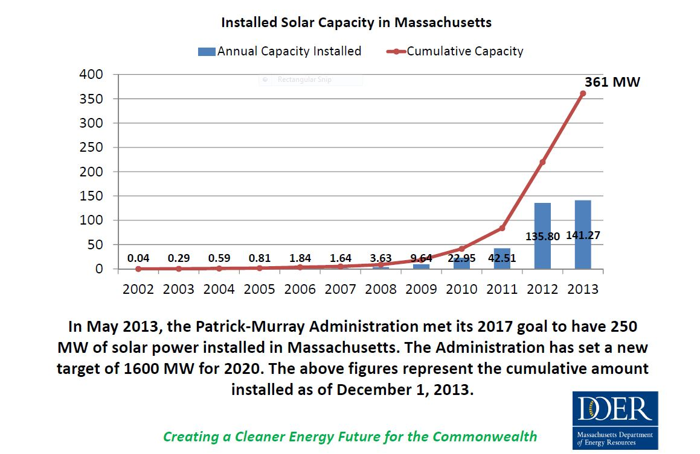
Remarkable Solar Growth in Mass.

Slide 3
Current/Projected Market Installations
To meet Governor’s 1600 MW goal, market needs to install 140-200 MW per year between 2014 and 2020 (adjusted for final SREC-I Capacity)
This installation rate maintains growth from 2012 installation rate, but does not sustain the accelerated market growth experienced in 2013.

Slide 4
SREC-II Policy Objectives
Provide economic support and market conditions to maintain and expand PV installations in MA
Control ratepayer costs
Maintain robust, progressive growth across installation sectors and manage growth to reach 1600 MW by 2020
Maintain competitive market of diverse PV developers, without undue burdens of entry
Address financing barriers limiting residential and non-profit direct ownership, without compromising third-party ownership model
Minimize regulatory complexity and maintain flexibilities to respond to changing conditions

Slide 5
SREC-II: Key Design Features
Program Cap of 1600 MW minus the capacity reached in SREC-I by June 30, 2014.
Projects eligible to generate SREC-IIs for 10 years (40 quarters), with incentive declining over time through a 10-year forward schedule of Auction Prices and ACP Rates. Units generate Class I RECs following 10 years of eligibility.
SREC Factors provide financial incentive differentiated between market sectors.
Review of SREC Factors 2016/2017 provides ratepayer and developer protections.
Forward Minting is eliminated. Residential direct-ownership market will be addressed with an ACP-funded financing program.
Managed Growth sector provided fixed SREC Factor and will not be subject to competitive solicitations. Qualifications will be limited by Annual Blocks made available on a two year forward schedule by DOER.
Compliance Obligation and Minimum Standard set in regulation for 2014 and 2015. Annual calculations thereafter based on actual and projected supply, constrained by Cumulative Installed Capacity Targets, which informs determination of next Annual Block for Managed Growth sector.

Slide 6
Reducing Incentive Value Over Time
 | $/MWh
Year | Auction Price Bid | Auction Price After 5% Fee | ACP Rate
2014 | 300 | 285 | 375
2015 | 300 | 285 | 375
2016 | 300 | 285 | 350
2017 | 285 | 271 | 350
2018 | 271 | 257 | 350
2019 | 257 | 244 | 333
2020 | 244 | 232 | 316
2021 | 232 | 221 | 300
2022 | 221 | 210 | 285
2023 | 210 | 199 | 271
2024 | 199 | 189 | 257
2025 | Values announced by DOER each year to maintain 10-year forward schedule.
2026
2027
2028
2029
2030
Auction Price and
ACP Rate Schedules
No change from prior Stakeholder Meetings
Values are included in regulation

Slide 7
Market Sectors and SREC Factors
(Factors Provided in Guideline)
Market Sector |  | SREC Factor
A | Residential, Parking Canopy, Emergency Power Generation, Community Shared Solar, or any Unit with a capacity <= 25 kW. | 1.0
B | Building Mounted, or ground mounted Unit with a capacity > 25 kW with 67% or more of the electric output on an annual basis used by an on-site load. | 0.9
C | Landfill or Brownfield, or a Unit with a capacity of <= 500 kW with less than 67% of the electrical output on an annual basis used by an on-site load. | 0.8
Managed Growth | Unit that does not meet the criteria of Market Sector A, B, or C. | 0.7
SREC Factor for Residential increased to 1.0.
Managed Growth has fixed SREC Factor (not subject to competition).
SREC Factors subject to evaluation in 2016/2017, to accommodate market/policy changes. Changes applied with delay.

Slide 8
Projection of Market Sector Growth
DOER anticipates Managed Growth Blocks will support significant market share.
Other Market Sectors will impinge on available Blocks depending on actual growth.
SREC-II generation will peak in 2020/2021, and then begin to taper to zero by 2030/2031, as 10-year eligibilities expire.
This projection represents one sample future outcome. While these data reflect DOER’s analysis of market trends, DOER does not endorse or suggest this to be the most likely outcome.

Slide 9
Residential Direct Ownership
ACP-funded Support Program
Elimination of Forward Minting: Questions raised about FM effectiveness in achieving objective to facilitate residential financing. DOER assessed significant administrative complexities.
DOER estimates that a robust residential direct ownership market would need to be supported by $20-50 million in loans annually at the start of the program, and $300-600 million cumulatively through 2020. This volume represents a significant opportunity for the financing/banking industry.
DOER plans to announce, in parallel with the SREC-II rulemaking, a financing support program using ACP funds. Final development of the program will be done in coordination with stakeholder input, including direct discussions with the banking industry.
DOER anticipates using approximately $30 million of ACP funds for this purpose. Leveraging funds will be important, along with strategies to enable banking sector to sustain lending as ACP support is diminished.
MassCEC will maintain CommSolar II rebate program through the development of the financing program.

Slide 10
Benefits and Costs of SREC-II
Over program life, benefits to the electric system and public outweigh program costs.
Actual SREC-II prices may be lower than Auction price, reducing program costs further.
Over program life, utility rate impact of program averages 1.2% and 1.5% of total bill, with peak impact of 2.5% to 3.5% (2018-2021 timeframe). For a typical residential monthly bill, impact is $0.91 to $1.48 over program life, and $2.44 to $3.49 at peak.
SREC-II brings solar into the market at incentive values 30-50 percent below SREC-I.
From DOER consultants report, Task 3b: Analysis of Economic Costs and Benefits of Solar Program

Slide 11
SREC-II and Net Metering
Most non-residential solar projects depend on the net metering credit incentive, along with SREC revenue
MA market is non-uniform in the availability and value of Net Metering credits by utility territory
DOER is cognizant of Net Metering caps being reached and impact on solar (and other renewables) economic feasibility
DOER currently has no policy stance on the raising of the NM caps
DOER has commissioned a study on NM policy and is evaluating cost/benefits and policy options to assist policy making. Study should be available at the end of 2013

Slide 12
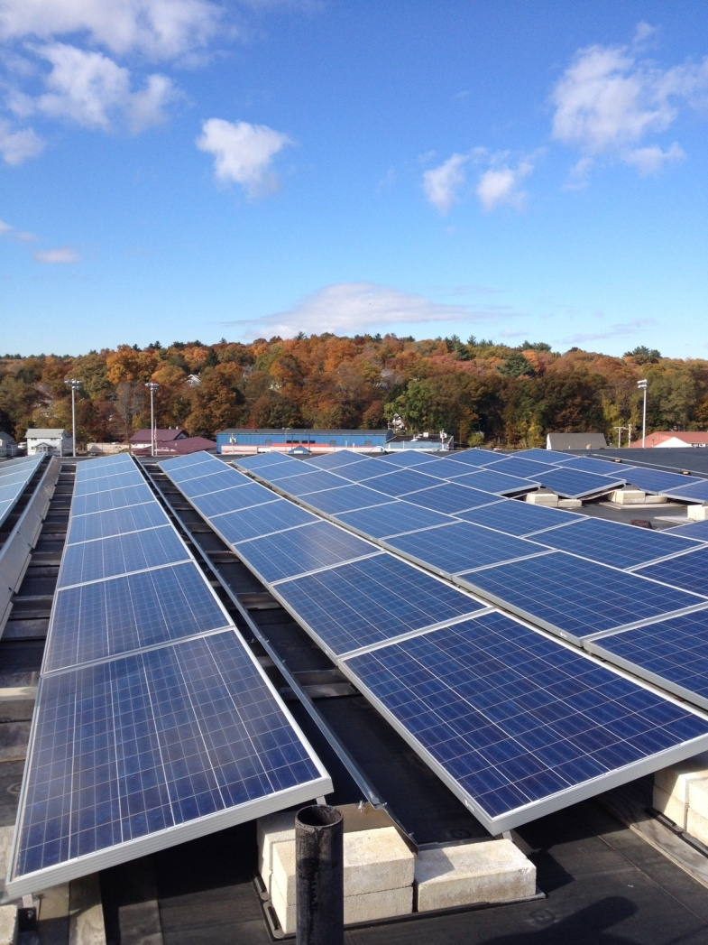
SREC-II Anticipated Rulemaking Process
RPS Class I regulation revisions for SREC-II are expected be filed any day
Rulemaking will include Public Hearing and comment period in January, followed by review by Joint Committee on TUE
DOER projects rule to be promulgated before the end of Q1 2014

Slide 13
Solar is Working for the Commonwealth
Residential solar PV prices dropped 28 percent in Massachusetts in 2012 − second biggest drop in the nation last year.
Governor’s goal of installing 250 MW by 2017 met four years early; new goal of 1600 MW by 2020.
Solar is well distributed throughout the Commonwealth, with installations in 346 of 351 MA cities and towns. Over 120 municipalities are hosting solar projects on town facilities.
Solarize Mass program has supported 9 MW of residential solar in 33 towns (another 15 towns are underway).
Massachusetts is well ranked nationally (SEIA 2012)
  6th in solar capacity installed in 2012
  7th in cumulative installed capacity
  3rd in commercial installations; 6th in residential installations
  2nd lowest weighted average commercial installation costs
  4th in total solar jobs; 8th in per capita solar jobs
Over 1800 firms in MA work primarily in the renewable energy sector, employing over 21,000 workers. Nearly 60% of renewable energy workers support the solar sector (2013 MassCEC Jobs Report).

Slide 14
Thank you!
Mark Sylvia
Commissioner
Massachusetts Department of Energy Resources
100 Cambridge Street, Suite 1020, Boston, MA 02114
617.626.7339
Mark.Sylvia@State.MA.US
www.mass.gov/doer
14

